Slide 1
To Do List

Slide 2
Team members
1- Azza Emam
2- Esraa Ahmed
3- Abdullah Aowad

Slide 3
Description
To Do List App is a kind of app that generally used to maintain our day-to-day tasks or list everything that we have to do.
The TO DO app lets a user create, read, update and delete to-do tasks. A task has a title , description, date and time

Slide 4
Features
In this version of the To Do list, the user will be getting four options :
Create (add) a new task or adding a new To Do in the To Do List App.
See all the tasks or View all the To Dos that were added to the app.
Delete any To Do from the list of To Dos.
Exit from the app

Slide 5
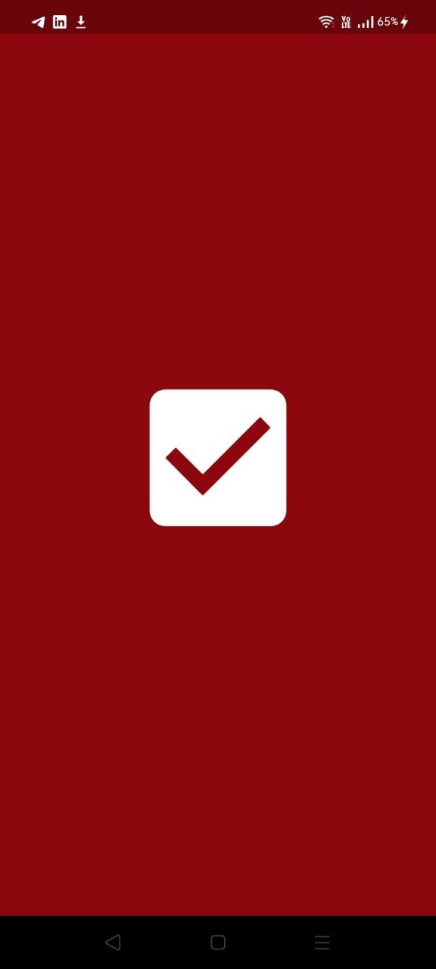
Splash screen

Slide 6
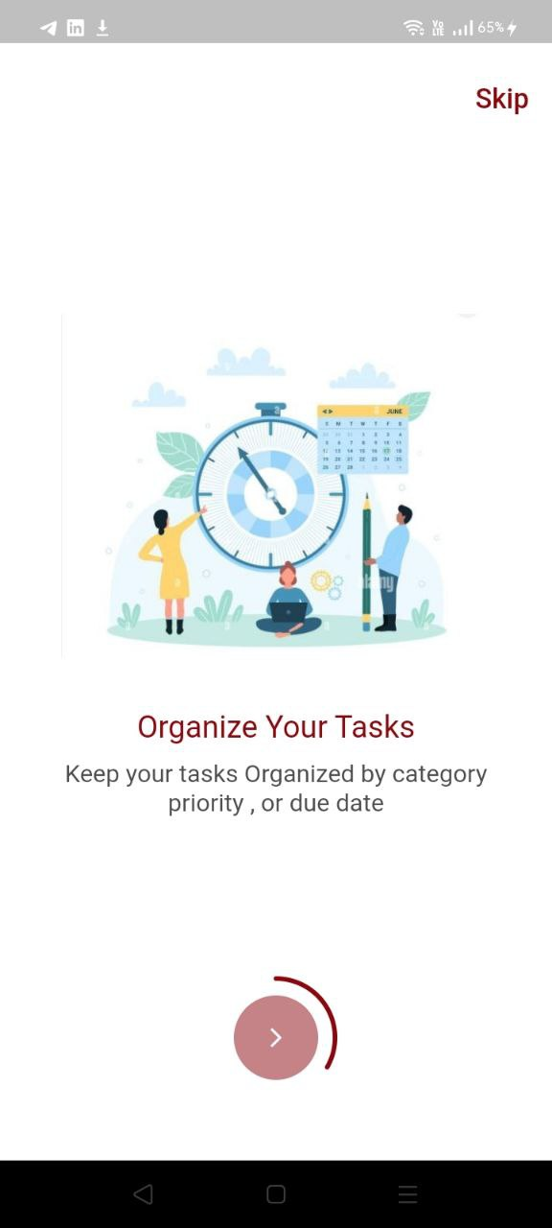
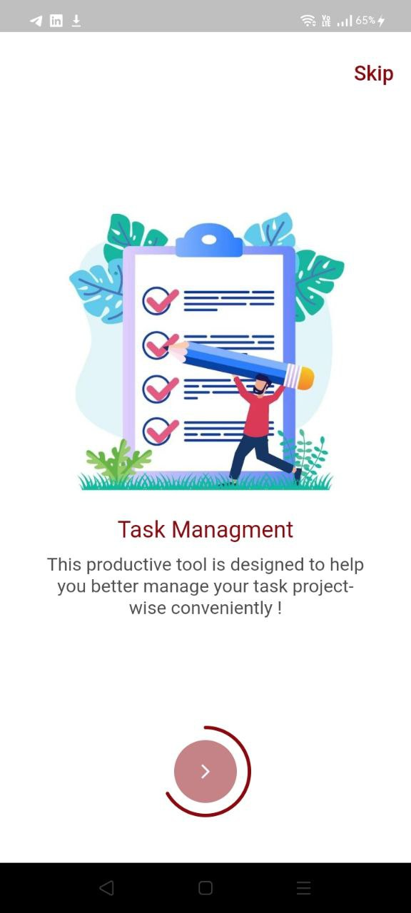
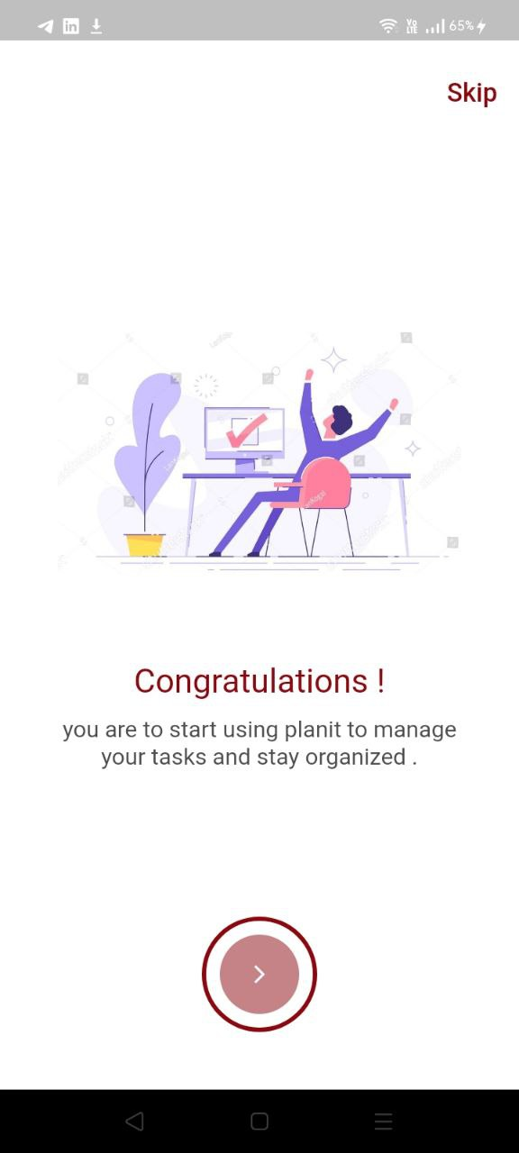
Onbording screen

Slide 7
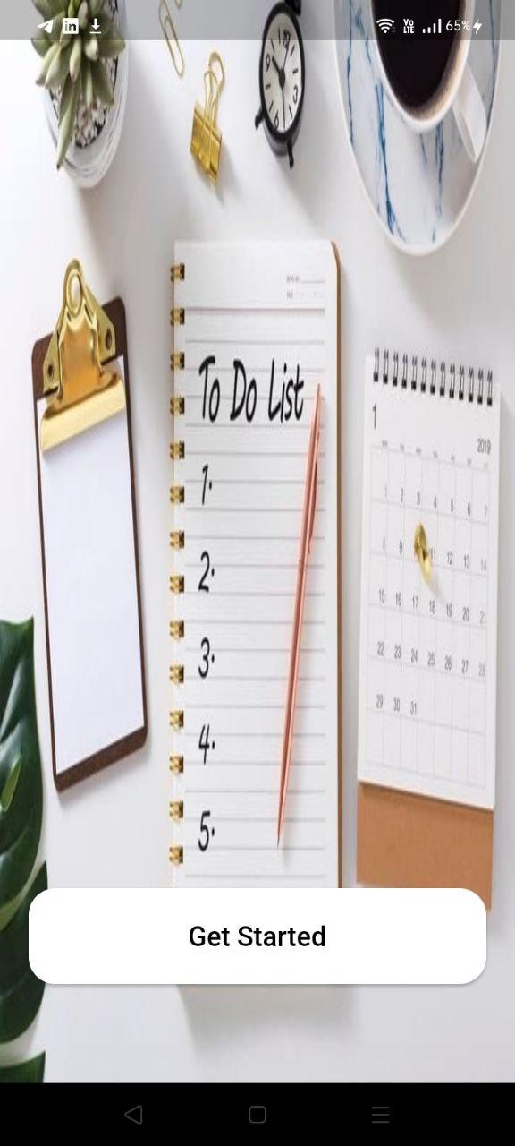
welcome screen

Slide 8
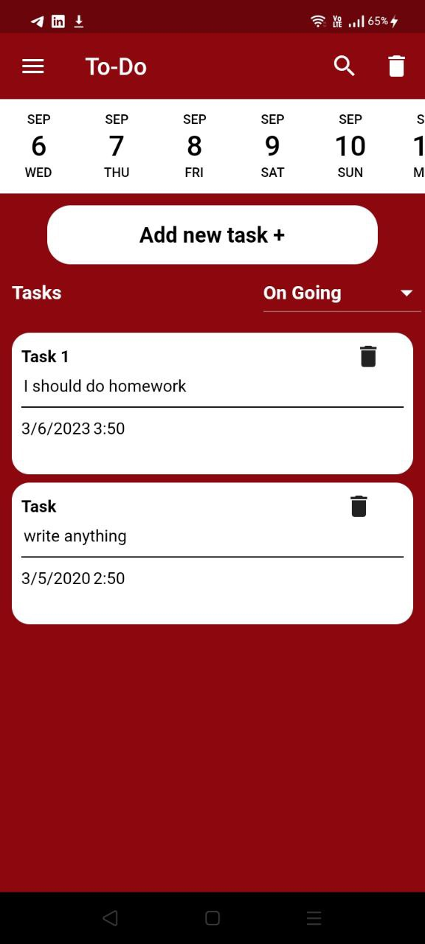
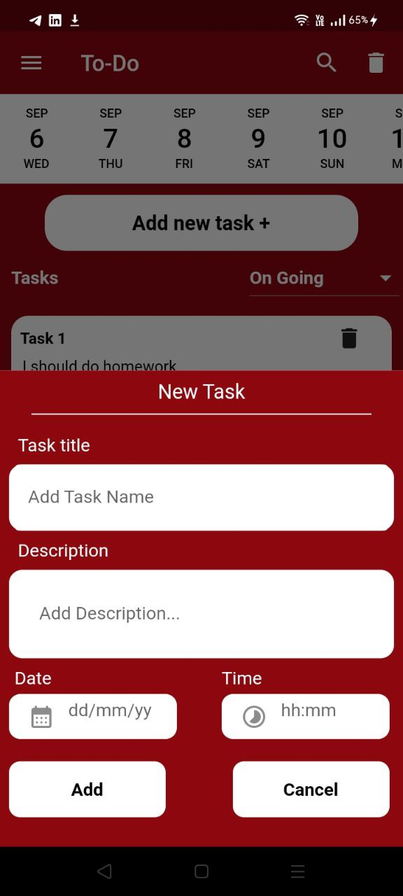

Home screen

Slide 9
Thank you

